Slide 1
Introduction of computer
Understanding the basics and functionality

Slide 2
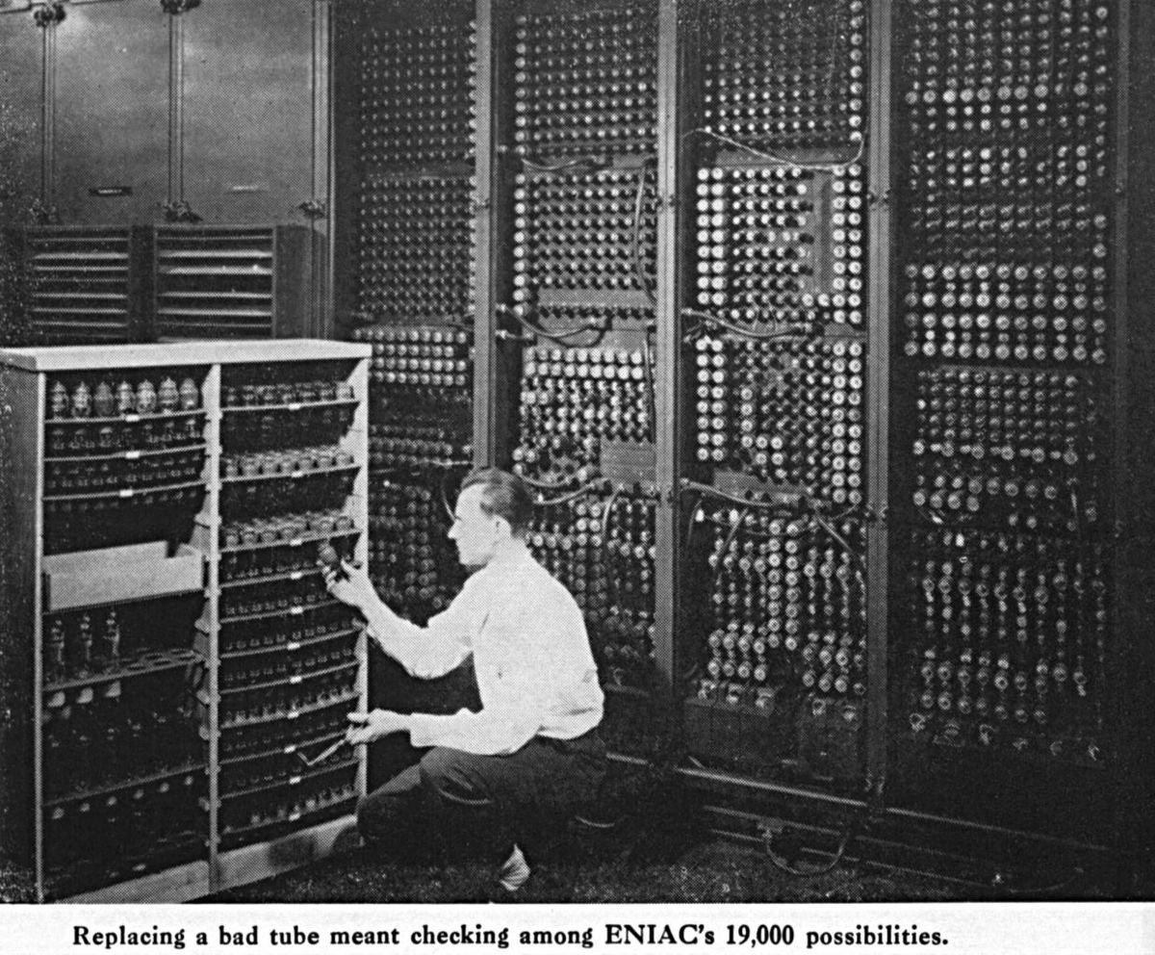
History of computers
Early mechanical computers
.Development of electronic computers
Milestones in computer technology

Slide 3
Types of computer
Personal computer
Laptops
Tablets
Servers
mainframes

Slide 4
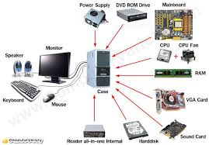
Basic component of a computer
Central processing unit
Memory
Storage
Input devices
Output devices

Slide 5
How computer work
Data input
Processing
Storage
output

Slide 6
Recent advances in computer technology
Artificial Intelligence
Quantum Computing
Internet of Things (IoT)

Slide 7
Future trends in computing
Predictive Analytics
Virtual Reality (VR) and
Augmented Reality (AR)
Enhanced Cybersecurity

Slide 8
conclusion
Summary of key points
Importance of understanding computer technology

Slide 9
Questions and answers
Open floor for questions

Slide 10
Thank you
Contact information
Closing remarks

